Slide 1
Encrypting files with Prime Number Cipher
Indronil Bhattacharjee
Roll : 1507105

Slide 2
Motivation
Encrypt a file with an prime encryption key.
Random person can not read the data of the file without knowing the key.
The person who knows the key, can decrypt the data to get the exact data.

Slide 3
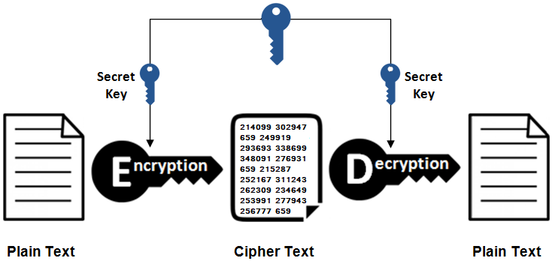
System functions

Slide 4
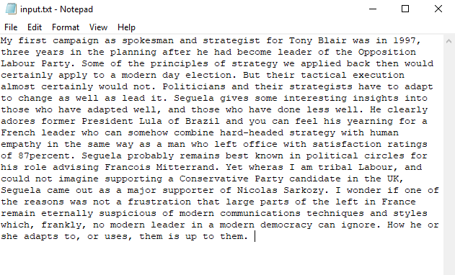
Original TEXT

Slide 5
How the encryption works
Let the key be prime number 71.
Starting from 71, ninety five primes will be generated and will be assigned for each characters which can be encrypted.
Then the text will be encrypted as the product of assigned primes of two consecutive characters and spaces.
Thus the whole data will be encrypted to numerical text from the original texts.

Slide 6
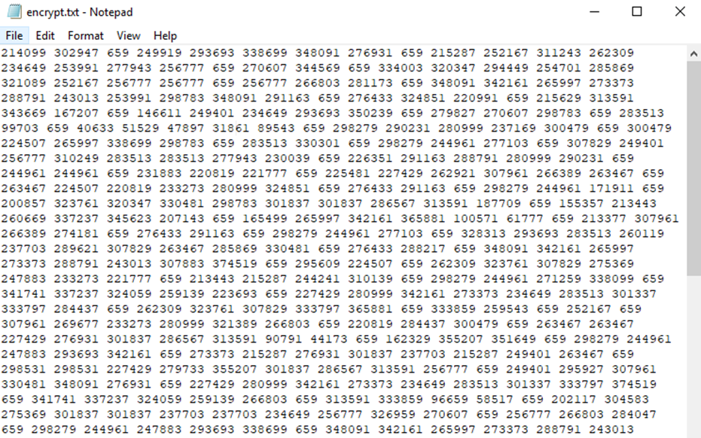
Encrypted TEXT

Slide 7
How the Decryption works
At first, the system will take the user’s key for decryption.
The system will generate a two dimensional array of products of assigned primes of the characters starting from the given key.
The system will check whether the numerical data in the file is divisible by the key.
If not, system will terminate.
Otherwise, it will divide first character, then check for the second with quotient and so on till the last number.
Thus the encrypted data will be decrypted to the original texts.

Slide 8

Decrypted Text

Slide 9
THANK YOU

